Slide 1

A CD of this message will be available (free of charge) immediately following today's message
This message will be available via podcast later this week at calvaryokc.com
2 Samuel
03-04

Slide 2
2 Samuel
03-04
Deut. 17:17 ~ Neither shall he multiply wives for himself, lest his heart turn away; nor shall he greatly multiply silver and gold for himself.
Chileab ~ like his father

Slide 3
2 Samuel
03-04

Slide 4
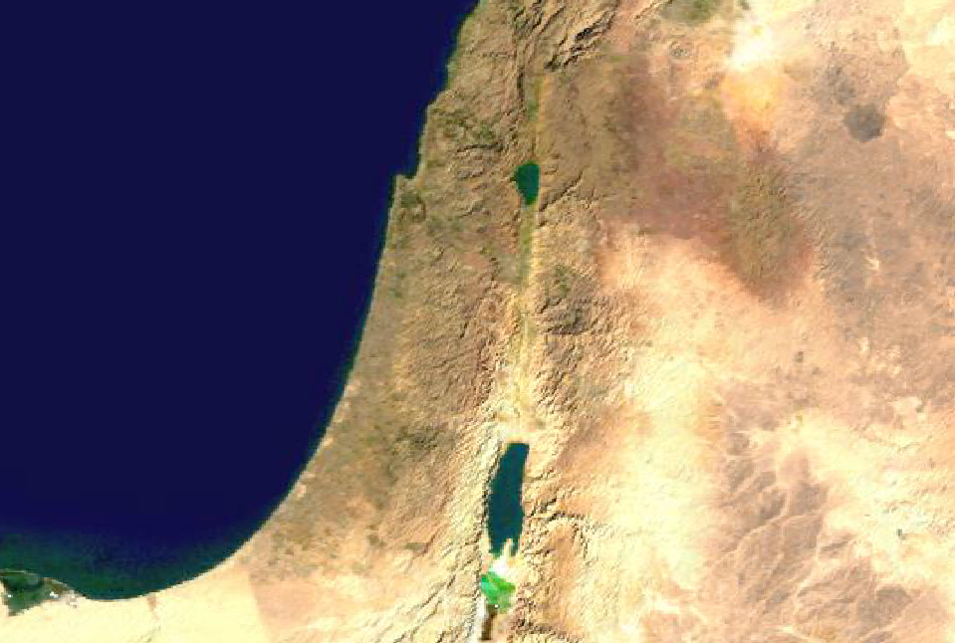
2 Samuel
03-04
Kadesh
Golan
Shechem
Ramath Gilead
Bezer
Hebron

Slide 5
2 Samuel
03-04
Deut. 19:11-13 ~ ¹¹ But if anyone hates his neighbor, lies in wait for him, rises against him and strikes him mortally, so that he dies, and he flees to one of these cities, ¹² then the elders of his city shall send and bring him from there, and deliver him over to the hand of the avenger of blood, that he may die. ¹³ Your eye shall not pity him, but you shall put away the guilt of innocent blood from Israel, that it may go well with you.
The Avenger of Blood ~ga`al

Slide 6
2 Samuel
03-04
In the gate ~ literally, in the middle of (NASB)

Slide 7
2 Samuel
03-04

Slide 8
2 Samuel
03-04
Phil. 2:3 ~ Let nothing be done through selfish ambition or conceit, but in lowliness of mind let each esteem others better than himself.

Slide 9
2 Samuel
03-04

Slide 10
2 Samuel
03-04
Mephibosheth
1st part ~ to cleave in pieces, break into pieces, shatter
2nd part ~shame or shameful thing
Exterminating the idol or he scatters shame

Slide 11
2 Samuel
03-04

